Slide 1

Effects of a general speed limit on two-lane highway traffic
Diego De los Santos, Daniel Nezamabadi, Natalie Suter, Róbert Veres, Victor Vitéz

Slide 2




Effects of a general speed limit on two-lane highway traffic
Introduction
Fundamental Questions
Expected Results
Model
IDM
MOBIL
Implementation
Simulation
Results
Meaning of Simulation Output
Extensions
Motivation
Effects of decreasing or removing the speed limit
Effect of Perturbations
Diego De los Santos, Daniel Nezamabadi, Natalie Suter, Róbert Veres, Victor Vitéz

Slide 3

Introduction

Slide 4
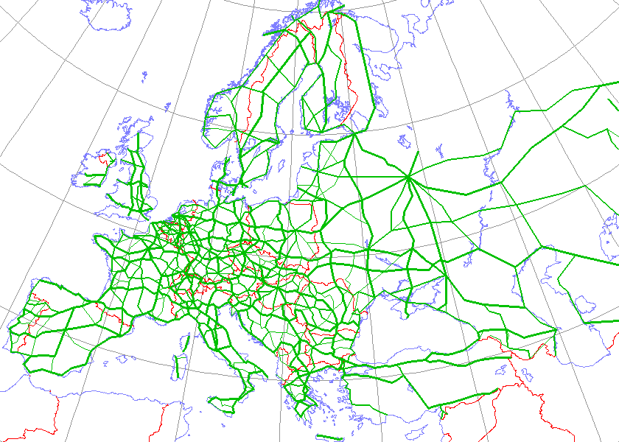
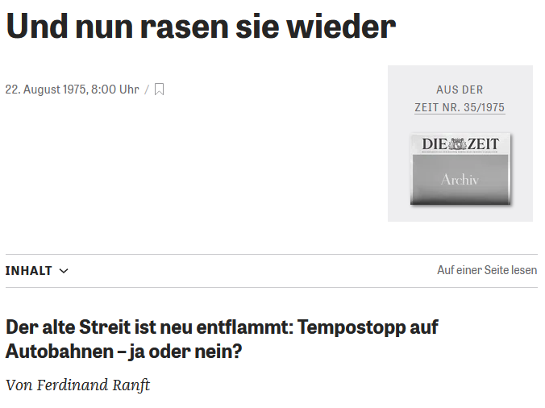
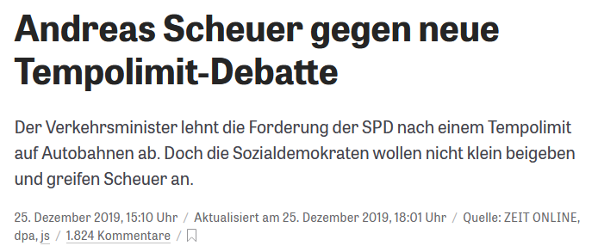
Motivation
Figure 1: E-Road Network over 1990 borders
By Kjhskj75 - http://en.wikipedia.org/wiki/Image:International_E_Road_Network.png, Public Domain, https://commons.wikimedia.org/w/index.php?curid=2875623
Figure 2: News article from 1975
Figure 3: News article from 2019
Notes:
Why?
Highways critical part of global infrastructure (Figure 1), used…
…to commute to work
…drive into holidays
…transport goods
Natural (especially as CS) wanting to optimize
sophisticated systems: communication between cars, autonomous driving
simple idea: general speed limit
Why look at general a speed limit
Relevant
Germany doesn’t have a general speed limit
Hotly debated all the time
Figure 2: 1975, “The old conflict has reignited: General speed limit on highways – yes or no”
Figure 3: 2019, “Andreas Scheuer (German Minister of Transport) against new general speed limit debate”
One argument seemingly brought up by both sides
Decreased travel time
Less traffic congestion
Higher speeds
→ Which argumentation makes more sense? Find out with simulation

Slide 5
Fundamental Questions and Expected Results
Fundamental Questions
Expected Results
How does a general speed limit affect highway traffic?
How do the results change when changing proportions and types of vehicles?
How do the results change when introducing random perturbations?
General speed limit decreases traffic congestion and thus increases highway throughput in basically all situations
Notes:
Fundamental Questions: From overall to more specific
How does a general speed limit affect highway throughput?
Does a general speed limit increase or decrease the average travel time
Argumentation we trying to analyze from last slide
How do the results change when changing proportions and types of vehicles
Highway not homogenous, different vehicle types and amount associated with them
More trucks? Less trucks?
How do the results change when introducing random perturbations?
Implementation will be explained
Car can suddenly slow down
React to a danger situation
Model something close to accidents
Expected Results:
General speed limit improves highway throughput/average travel time in basically all situations
Rational: Decreases differences in speed between individual cars → less traffic congestion

Slide 6
The Model
Notes:
Say what we needed our model to be able to do: give each car an individual driving style -> So we chose IDM

Slide 7

Intelligent Driver Model
IDM
Car-following Model
Output based on the state of the car and the leading vehicle
Accident-free
Driving style described by parameters

Slide 8

Intelligent Driver Model
v₀
Desired Speed
T
a
Maximum acceleration
s₀
b
Time Headway
Desired deceleration
Jam Distance

Slide 9
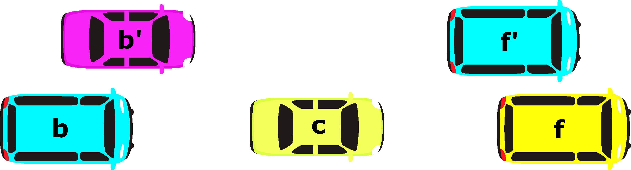
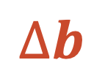

MOBIL
Politeness factor
Maximum safe deceleration
Threshold
Right Bias
Safety Criterion
Incentive Criterion
p
b_{save}
$$δ$$
$$∆b$$

Slide 10
Extensions
Disturbances
Trucks

Slide 11
Implementation
Notes:
Say what we needed our model to be able to do: give each car an individual driving style -> So we chose IDM

Slide 12
Structure overview
Simulation
Metrics
Road
Car
Car
Car
DriverModel

Slide 13
In more detail: Simulation
Types of cars, simulation parameters (like the time step, road length, etc.)
Simulation
update(delta_t)
List of Car Objects and car_reached_end
Road

Slide 14
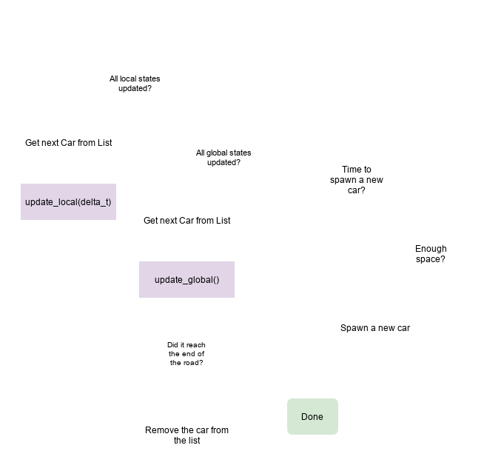
In more detail: Road
What happens during update(delta_t)?
Road
update_local(delta_t)
update_global()
Car

Slide 15
In more detail: Car
def update_local(self, delta_t):
Randomly break down with a given probability.
Get other cars around and decide if a lane change should happen by calling the DriverModel Class.
Update the position in the local state based on the lane change decision and the current speed in the global state.
Update the acceleration and speed in the local state by calling the DriverModel Class.
def update_global():
Update the speed and position in the global state based on those in the local state.
How we define different car types:
Set the IDM and general Car parameters each as either a 2-tuple (average, width) describing a normal distribution, or a number.
If the parameter is a tuple, a random value in the defined distribution will be picked at random when the car is spawned. Otherwise, the given number will be applied.
A car type will be picked based on the given ratio when a car is spawned.

Slide 16
Results
Notes:
Say what we needed our model to be able to do: give each car an individual driving style -> So we chose IDM

Slide 17

Results
First goal:
Figure out whether we can improve the highway throughput by decreasing
or removing the
speed limit

Slide 18


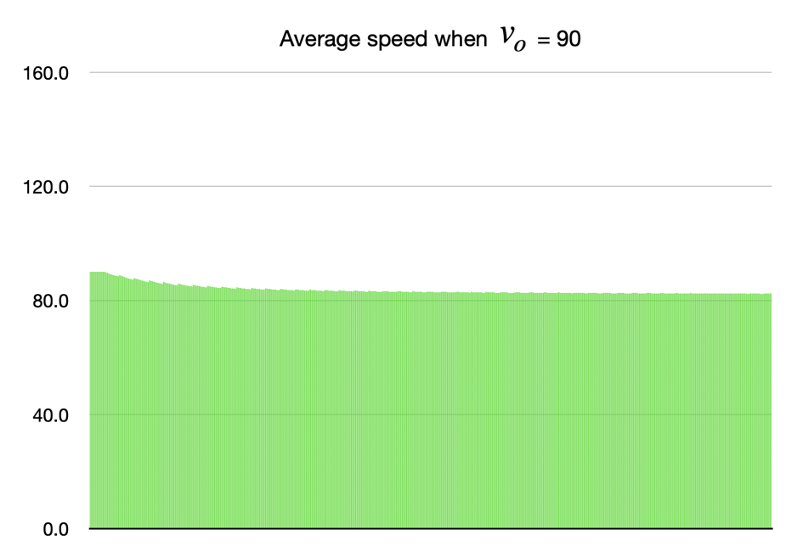
Results - decreased speed limit
Parameters were set to: $v_{0}=90km/h,p_{fail}={10}^{−6}$
Besides random perturbation, we see congestions that should only happen in an environment with speed deviation. Average speed: 83.70 km/h

Slide 19


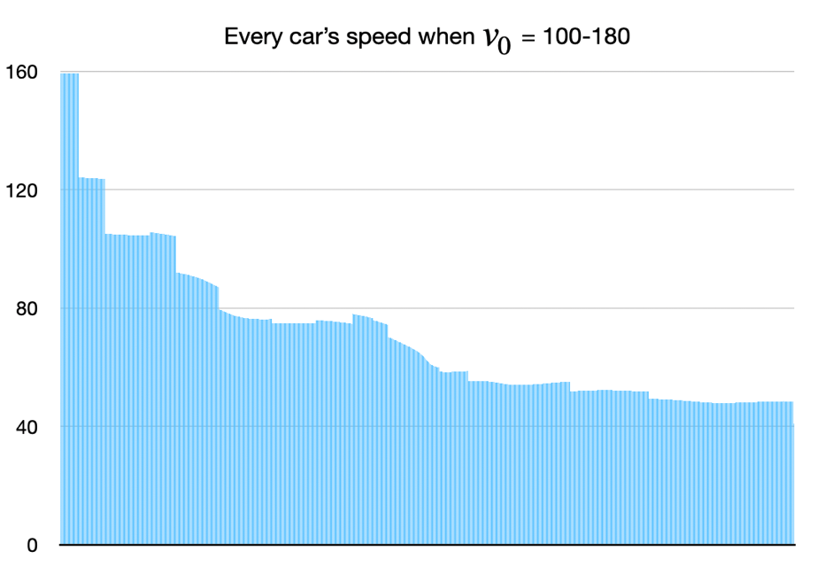
Results - without speed limit
Parameters were set to: $v_{0}=100−180km/h,p_{fail}={10}^{−6}$
Slower cars can “collect” faster vehicles behind them Average speed: 70.92km/h

Slide 20

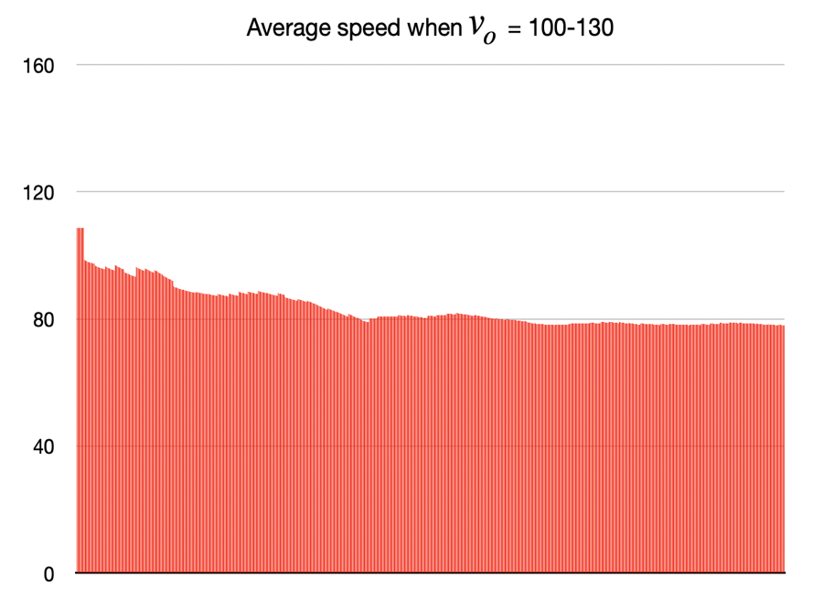
Results - comparison
83.70km/h
83.49km/h
70.49km/h
83.26km/h without the first 30 cars

Slide 21

Results

Slide 22
Results
Second question:
How do disturbances
affect the highway
throughput?

Slide 23

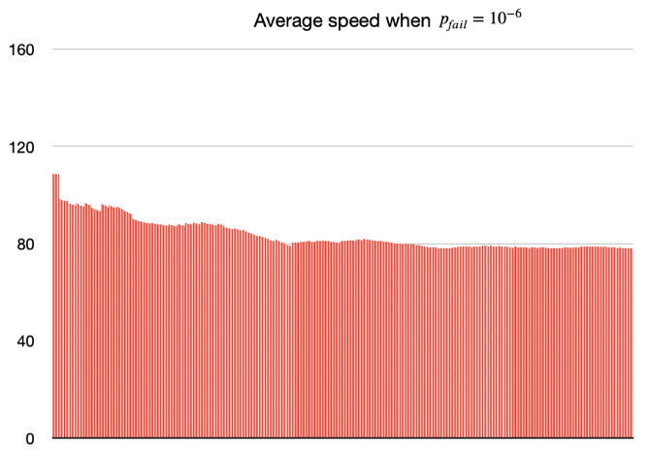

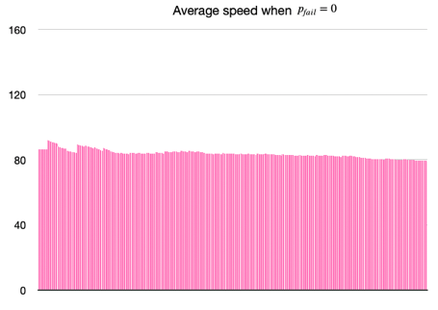
Results - comparison
With perturbation
Without perturbation
Average speed: 83.49
Without the first 30 cars: 83.26
Average speed: 83.67
Without the first 30 cars: 83.64

Slide 24



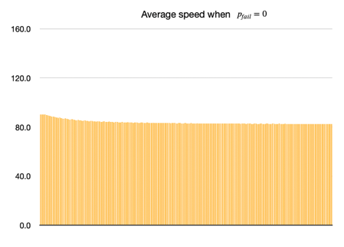
Results - comparison
With perturbation
Without perturbation
Average speed: 83.70
Without the first 30 cars: 83.60
Average speed: 83.70
Without the first 30 cars: 83.62

Slide 25
Results - comparison
With perturbation
Without perturbation
Average speed: 83.70
Without the first 30 cars: 83.60
Average speed: 83.71
Without the first 30 cars: 83.62
Cars breaking down don’t change that much

Slide 26
Thank you for your Attention
Notes:
Say what we needed our model to be able to do: give each car an individual driving style -> So we chose IDM

Slide 27
Sources
[1] Ferdinand Ranft. Und nun rasen sie wieder, 1975. URLhttps://www.zeit.de/1975/35/und-nun-rasen-sie-wieder.
[2] ZEIT ONLINE.Andreas scheuer gegen neue tempolimit-debatte,2019.URLhttps://www.zeit.de/politik/deutschland/2019-12/verkehrsminister-tempolimit-debatte-andreas-scheuer-spd.
[3] Martin Treiber, Ansgar Hennecke, and Dirk Helbing. Congested traffic statesin empirical observations and microscopic simulations.Physical Review E, 62:1805–1824, 02 2000. doi: 10.1103/PhysRevE.62.1805.
[4] Martin Treiber and Dirk Helbing. Realistische mikrosimulation von straßen-verkehr mit einem einfachen modell. 01 2002.
[5] Martin Treiber. The intelligent-driver model and its variants, . URLhttps://traffic-simulation.de/info/info_IDM.html.
[6] Vector image (cars).URLhttps://www.vecteezy.com/free-vector/car-above.
[7] Martin Treiber.The lane-change model mobil, .URLhttps://traffic-simulation.de/info/info_MOBIL.html.
[8] Iii. the freight transportation system, . URLhttps://ops.fhwa.dot.gov/freight/freight_analysis/nat_freight_stats/docs/10factsfigures/pdfs/fff2010_ch3.pdf.
[9] Straßengüterverkehr in baden-württemberg, .URLhttps://www.statistik-bw.de/Service/Veroeff/Statistik_AKTUELL/803413004.pdf.
[10] Kai Nagel and Maya Paczuski. Emergent traffic jams.Physical Review E, 51(4):2909–2918, Apr 1995. ISSN 1095-3787. doi: 10.1103/physreve.51.2909. URLhttp://dx.doi.org/10.1103/PhysRevE.51.2909.

